Slide 1
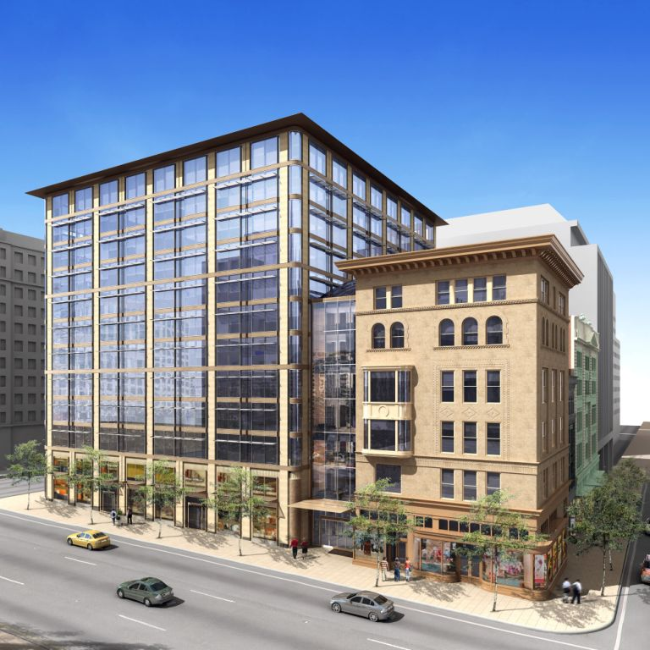
SQUARE 320
1199 F Street, NW – Wash, DC
Michael Webb
Charleston, South Carolina
Architectural Engineering
Construction Management
The Pennsylvania State University
PACE Research Seminar 2009

Slide 2
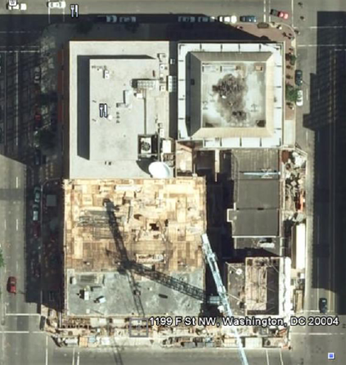
SQUARE 320 Project - “Enabling Synergy Among Renovation Teams”
Project Background
New 12-story Class A Office Tower
Renovation of 3 historic buildings
Rejuvenate the District’s West End
1199 F Street
Wash DC, NW

Slide 3
SQUARE 320 Project - “Enabling Synergy Among Renovation Teams”
Scope of Research
PACE Roundtable:
Historical Renovations
=> Growing Market
Energy cost savings in the name of sustainability
Require less capital & incur less risk

Slide 4
v
SQUARE 320 Project - “Enabling Synergy Among Renovation Teams”
What is the Diagnosis?
Square 320 was challenged with:
Concealed Conditions
Poor communication between all parties
RFIs lasting 100+ days
Months of delays
Additional costs
Frustrating project climate
Perception of minimal accountability & job ownership

Slide 5
SQUARE 320 Project - “Enabling Synergy Among Renovation Teams”
“Enabling Synergy Among Renovation Teams”
Overarching Theme
Methods that will unlock the potential synergy among renovation teams
Various parties are united to achieve greater success as a whole

Slide 6
v
SQUARE 320 Project - “Enabling Synergy Among Renovation Teams”
3 Focus Areas
Cohesion
Level of Influence
Innovation
Critical & Forward Thinking teams
Emotional Intelligence
Monitoring the project climate & developing working relationships

Slide 7
v
SQUARE 320 Project - “Enabling Synergy Among Renovation Teams”
Emotional Intelligence
=> “People Skills” or “Being a People person”
Definition:
The capacity to recognize one‘s feelings and those of others, for motivating ourselves, and managing our own emotions and emotions within our relationships

Slide 8
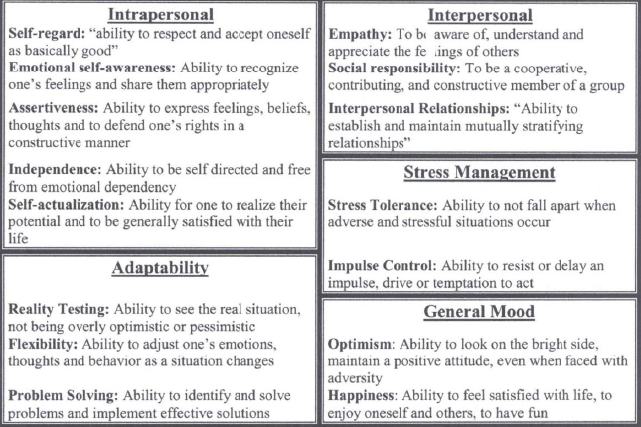
v
SQUARE 320 Project - “Enabling Synergy Among Renovation Teams”
Core Competencies

Slide 9
v
SQUARE 320 Project - “Enabling Synergy Among Renovation Teams”
Why is emotional intelligence important to our industry?
Technical “know-how” only gets you your first job
Teamwork & Communication are vital for success
Better understanding of oneself and others leads to better management
Challenges with working relationships on a jobsite can be minimized reducing potential delays Monitors the individual & job climate
Ideally, teams can be designed based on EQ

Slide 10
SQUARE 320 Project - “Enabling Synergy Among Renovation Teams”
Emotional Intelligence
Ability to perceive one’s emotions and those in other relationships
Used as a tool = Monitoring agent that tracks development among people & teams
Insight into each individual & project climate simultaneously
Enables focused efforts at benefiting each individual & project
Allows tailoring project climate to highlight teams strengths
…Ultimately, enabling synergy among renovation teams

Slide 11
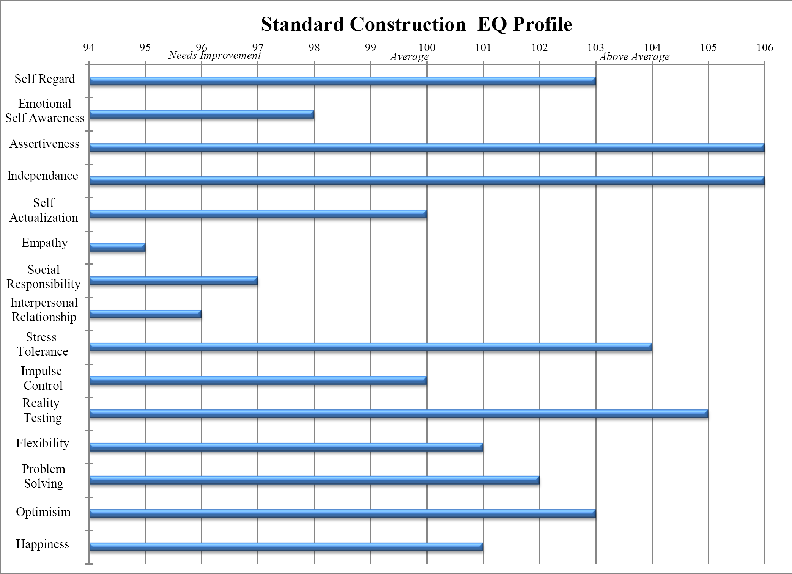
v
SQUARE 320 Project - “Enabling Synergy Among Renovation Teams”
Core Competencies
Courtesy of Brent Darnell

Slide 12
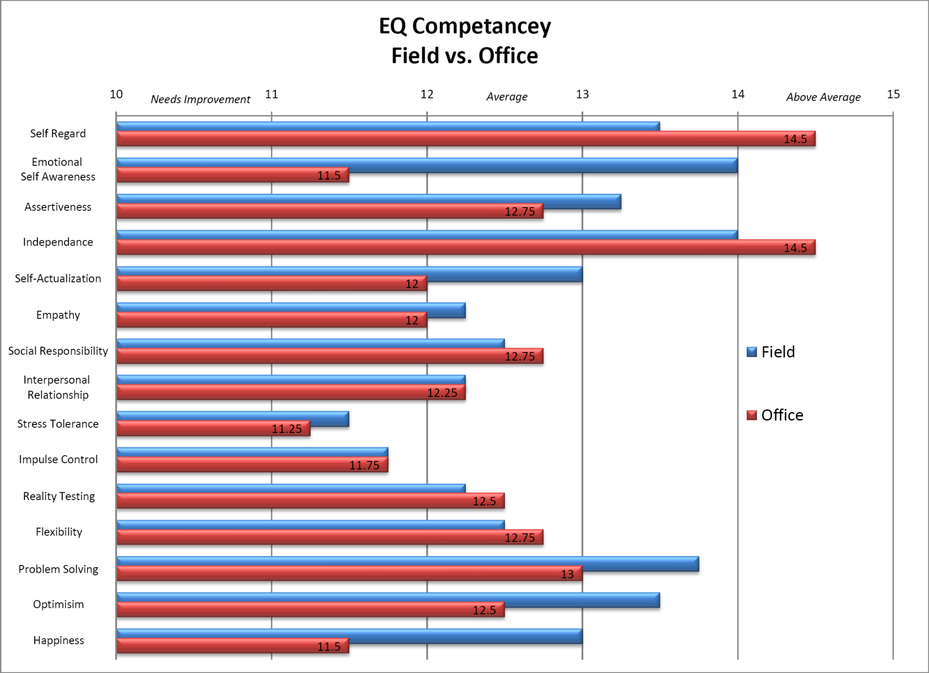
v
SQUARE 320 Project - “Enabling Synergy Among Renovation Teams”
Courtesy of Brent Darnell

Slide 13
v
SQUARE 320 Project - “Enabling Synergy Among Renovation Teams”
Conclusions
Low stress tolerance & impulse control + low optimism & self-actualization
=> Burnout profile
High self-regard, independence & self-awareness + low empathy & interpersonal relationship skills
=> Dysfunctional relationships
Office Team
Empathy, self-awareness, and happiness scores are considerably lower than the field
=> Poor relationship skills
=> Strained, frustrated and tired
Low stress tolerance but Field has higher optimistic & self-aware
=> Handle stress better

Slide 14
v
SQUARE 320 Project - “Enabling Synergy Among Renovation Teams”
Courtesy of Brent Darnell

Slide 15
v
SQUARE 320 Project - “Enabling Synergy Among Renovation Teams”
Field vs Office Relationships
EQ is a snapshot of the present; Reflection of the current project climate
Strained working relationships contrasted w/ proud workers
=> Industry expects projects to be hard and troublesome
Office bogged down with communication /relationship problems the project faces + near completion
=> Feel burnt out
Perhaps the Field feels as though they’ve been ‘thrown to the wolves’,
…(i.e. - challenging project with limited info and poor communication)
=> Forced into reactionary problem solving

Slide 16
v
SQUARE 320 Project - “Enabling Synergy Among Renovation Teams”
Results Tested
Held follow-up interview with members from each team to determine accuracy of results & interpretations
Found that the EQ results painted the picture exactly how they have experienced the project

Slide 17
v
SQUARE 320 Project - “Enabling Synergy Among Renovation Teams”
Potential For Growth
Periodic EQ Assessments for Key Players:
in the CM Field & Office, Arch, Lead Contractors
Individual & Organizational Growth
Effective Collaboration
Schedule Acceleration
Cost Savings

Slide 18
v
SQUARE 320 Project - “Enabling Synergy Among Renovation Teams”
Applicability
A Straight Forward Guide to Self-Improvement:
Encourages Self-Awareness
Requires Self-Monitoring & Accountability
Become Highly Adaptive
Enables Individuals to Maximize Their Potential

Slide 19
v
SQUARE 320 Project - “Enabling Synergy Among Renovation Teams”
Thank You
Pennsylvania State University
Dept of Architectural Engineering
To whom made it all possible:
Brent Darnell,
Jonathan Dougherty
Tyler Moyer, Bill Moyer, Keith Foote
Joe Romano
Nate & Julie Patrick
Professors: D. Riley, M. Horman, R. Holland
James C. Davis Construction Corp., Southland Industries, WadeTrim, Langan Engineering, Berding Surveying, Darling Environmental & Surveying

Slide 20
v
SQUARE 320 Project - “Enabling Synergy Among Renovation Teams”
Thank You
Pennsylvania State University
Dept of Architectural Engineering
To whom made it all possible:
Brent Darnell,
Jonathan Dougherty
Tyler Moyer, Bill Moyer, Keith Foote
Joe Romano
Nate & Julie Patrick
Professors: D. Riley, M. Horman, R. Holland
James C. Davis Construction Corp., Southland Industries, WadeTrim, Langan Engineering, Berding Surveying, Darling Environmental & Surveying

